Slide 1
Cyber Attacks & Cybersecurity Tools:
An Overview
Presented by Md. Abdul Hai Al Hadi
March 11, 2023

Slide 2
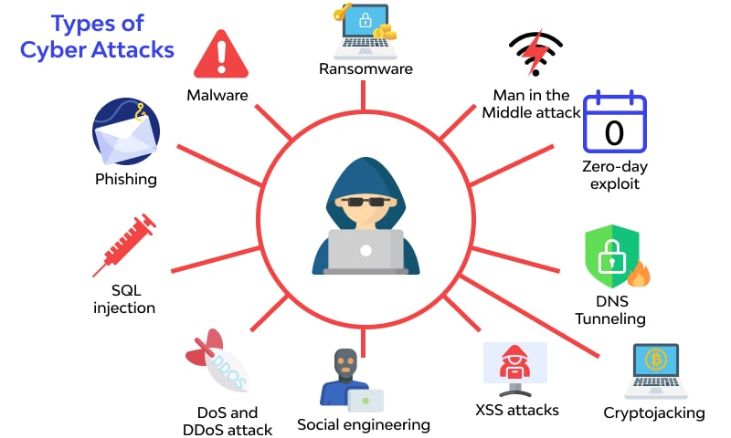
Different types of cyber-attacks
There are many varieties of cyber attacks that happen in the world today.
If we know the various types of cyber attacks, it becomes easier for us to protect our networks and systems against them.

Slide 3
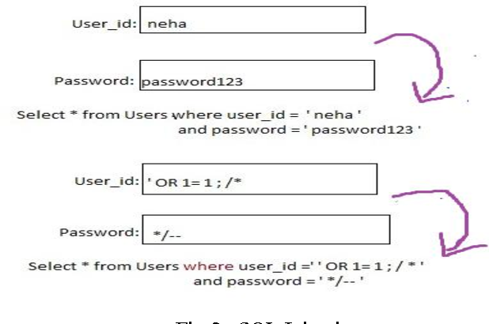
SQL Injection Attack
SQL is the code used to communicate with a database.
In an SQL injection attack, the hacker writes vindictive SQL code and inserts it into a victim’s database, in order to access private information.

Slide 4
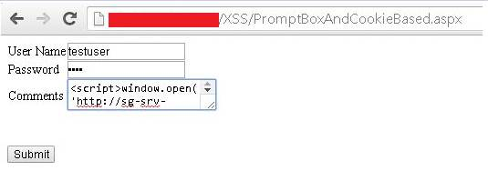
Cross-site scripting (XSS)
This is another type of injection attack in which an attacker injects data, such as a malicious script, into content from otherwise trusted websites.
This allows an attacker to execute malicious scripts written in various languages, like JavaScript, Java, Ajax, Flash and HTML, in another user's browser.
XSS enables an attacker to steal session cookies, allowing the attacker to pretend to be the user, but it can also be used to spread malware

Slide 5
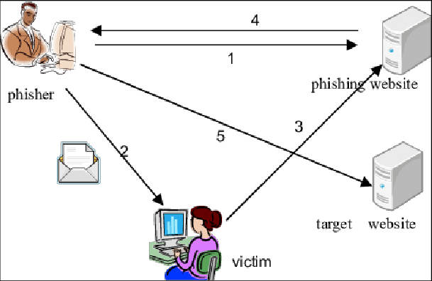
Phishing Attack
When a cyber-criminal poses as a legitimate institution and emails a victim to gain personal details like login credentials, home address, credit card information.

Slide 6
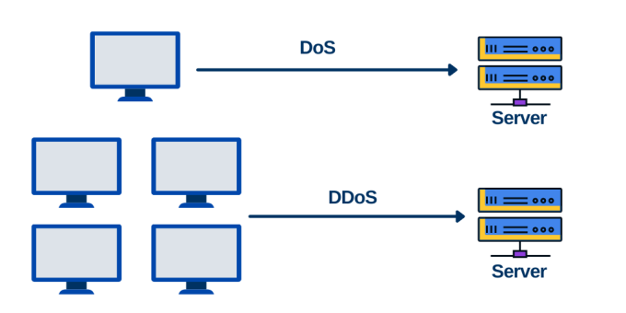
Denial of Service Attack (DoS)
This involves flooding a victim’s system with traffic, to the point where their network is inaccessible.
The hacker doesn’t gain any valuable information from this style of attack.

Slide 7
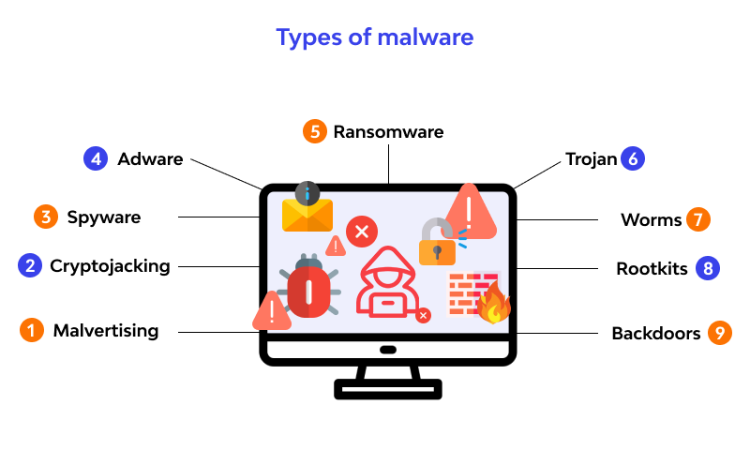
Malware Attack
A malware attack is a common cyber attack where malware (normally malicious software) executes unauthorized actions on the victim’s system.
Cyber attackers create, use and sell malware for many different reasons, but it is most frequently used to steal personal, financial or business information.

Slide 8

Ransomware Attack
Ransomware is a malware designed to deny a user or organization access to files on their computer.
By encrypting these files and demanding a ransom payment for the decryption key

Slide 9
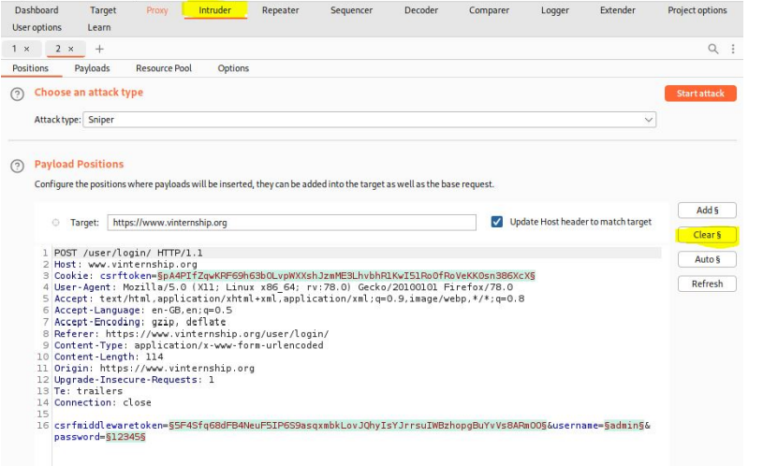
Cyber Security Tool: Burp Suite
Download link,
https://portswigger.net/burp/communitydownload
Then install and open

Slide 10
What is Burp Suite?
Burp Suite is an integrated platform and graphical tool for performing security testing of web applications
It supports the entire testing process, from initial mapping and analysis of an application's attack surface, through to finding and exploiting security vulnerabilities.

Slide 11
Burp Suite: how to launch your first automated vulnerability scan
Step 1: Open the scan launcher. Go to the Dashboard tab and select New scan. ...
Step 2: Enter the URL of the target site. ...
Step 3: Configure the scan. ...
Step 4: Launch the scan. ...
Step 5: See the crawl in action. ...
Step 6: View the identified issues.

Slide 12
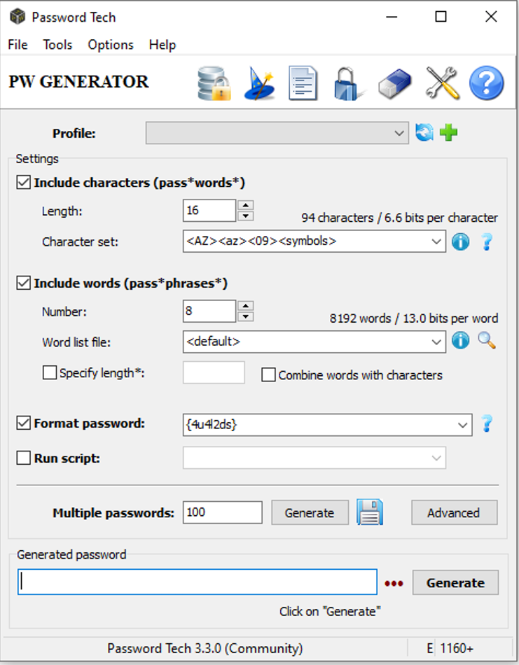
Cyber Security Tool: PWGen
Download link,
https://pwgen-win.sourceforge.io/download/
Then install and open

Slide 13
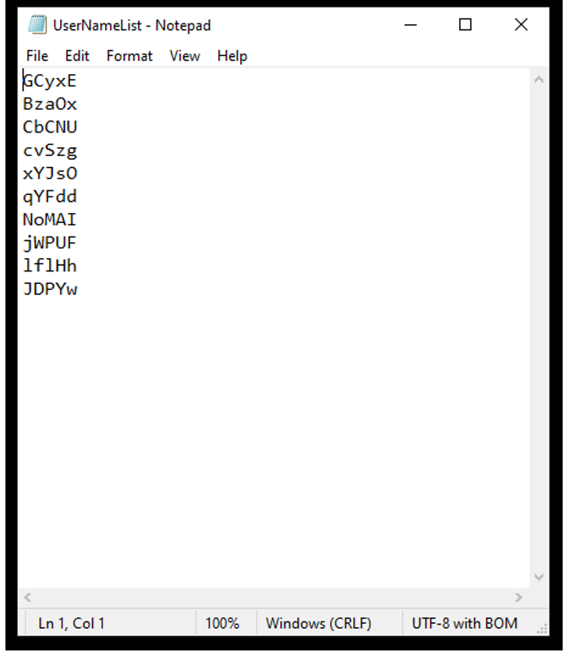
Generate User Name
Using PWGen for Cyber Attacks

Slide 14
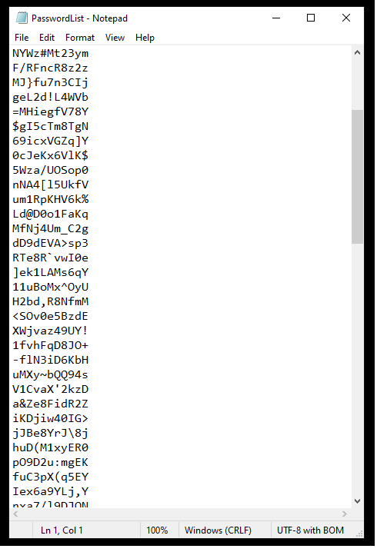
Generate Password
Using PWGen for Cyber Attacks

Slide 15
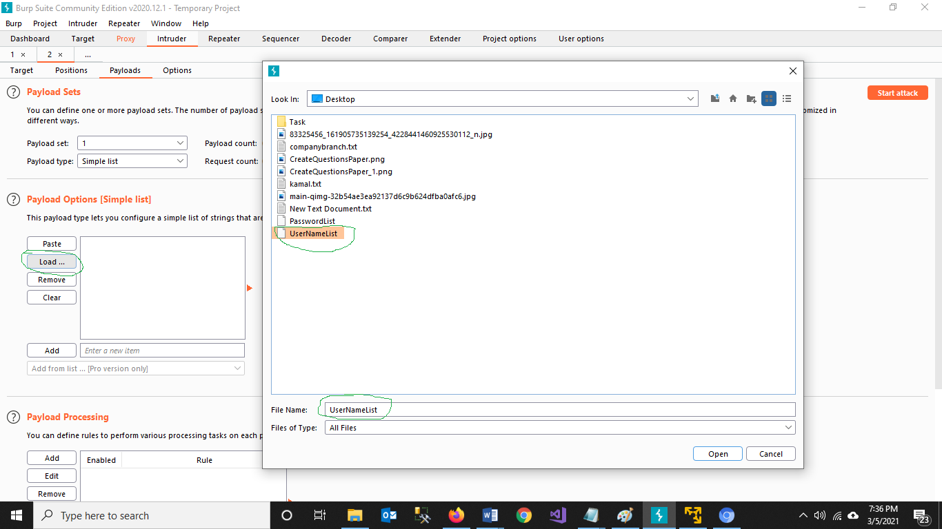
Payloads, Load User Name

Slide 16
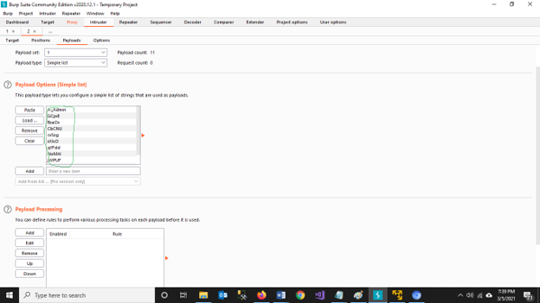
Payloads, Load User Name

Slide 17
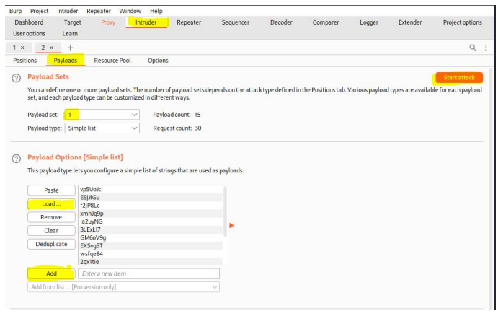
Start attack

Slide 18
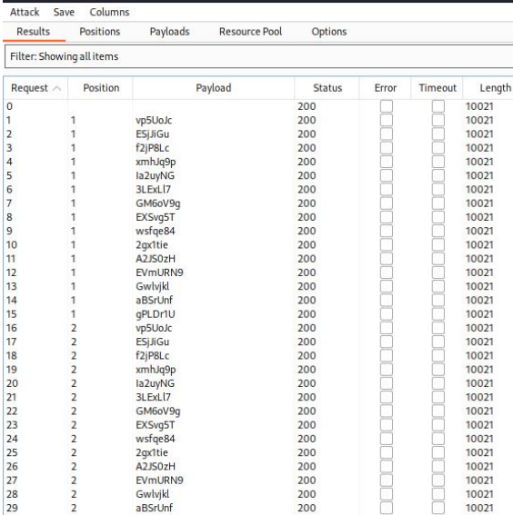
Output of the Attack
If you get successful in your attack then the status will be 302.

Slide 19
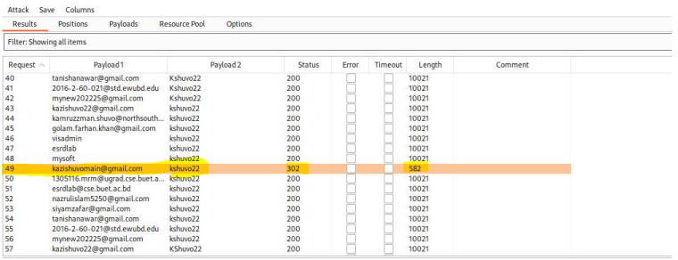
Successful Attack

Slide 20
Thanks

